Slide 1




React (Frontend) Workshop
LAs:
Paul Serafimescu
Qianli Wu

Slide 2
Agenda
JavaScript
React
Demo

Slide 3
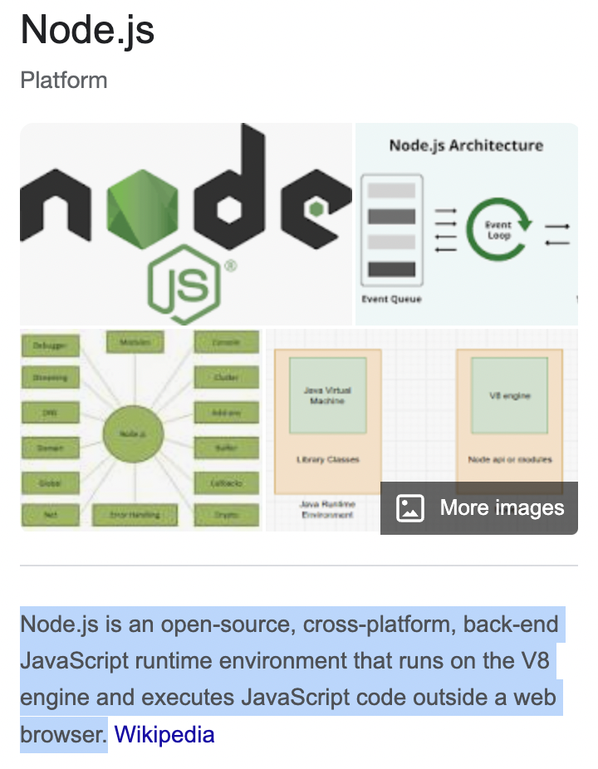
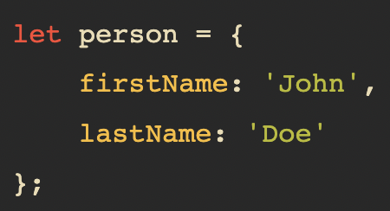
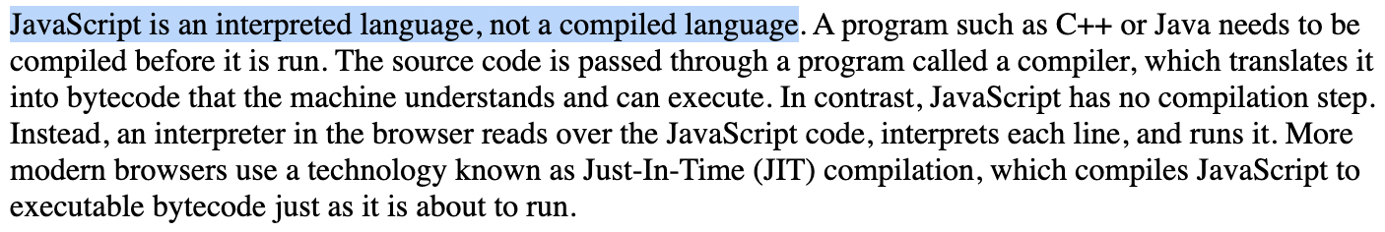
Introduction
Interpreted
What is Node.js?
Everything is an object!
JSON
source: https://web.stanford.edu/class/cs98si/slides/overview.html

Slide 4

Javascript

Slide 5
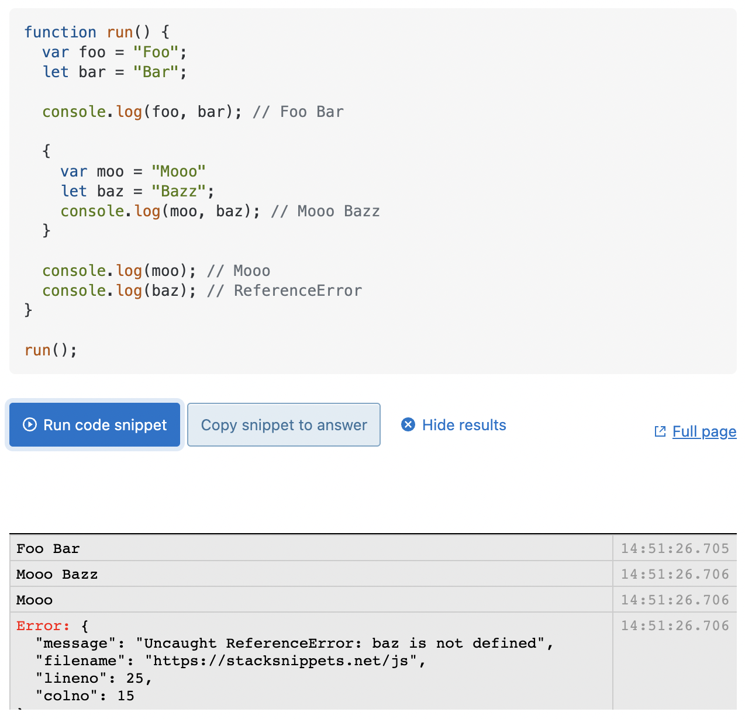
Variables
var (function scope 🤨)
let (block scope 🫶)
const (block scope 🫶)
hoisting
a variable can be declared after it has been used
JavaScript only hoists declarations, not initializations
https://www.w3schools.com/js/js_hoisting.asp
Helpful link: let vs var
Notes:
Before we talking about these keywords,
The scope of a variable is the part of a program where a variable is valid (can be accessed)
JavaScript is one of the only mainstream languages that has different scoping rules depending on what keyword you use.
(variables in Python)
If you declare a variable by `var` in function `run()`, it’s accessible throughout the function.
However, if you use `let` to define a variable in a block, it will be out of scope after the closing bracket which it was defined. (Like variables in C++)
Also, In JavaScript, a variable can be declared after it has been used.
Before execute the code, JS moves the variable and function declarations to the top of their scope
The variable declared with `const` keywords cannot be redeclared or reassigned, and it must be assigned a value when they are declared!

Slide 6

Interpret JS in the Browser
Notes:
In Chrome, you can run JavaScript in the console by right clicking and selecting “Console”

Slide 7
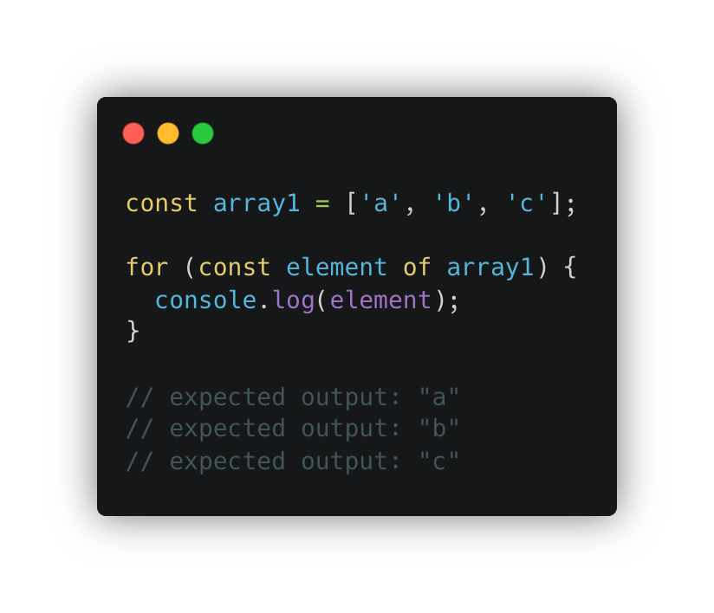
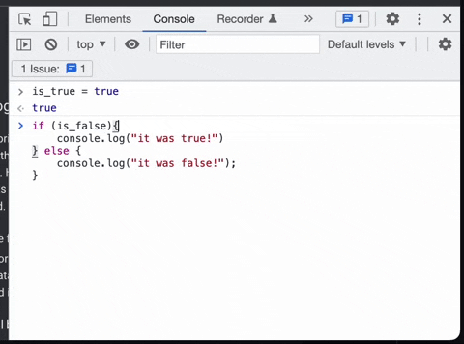
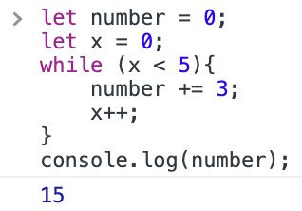
Control Flow
if
for
while
Notes:
JS control flow is similar with other languages that you are familiar with
There’re if-else-statements, for loops, and while loops
Also you can use switch, like structural pattern matching in Python 3.10

Slide 8
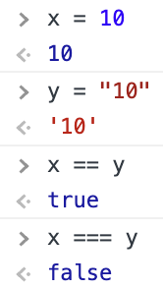
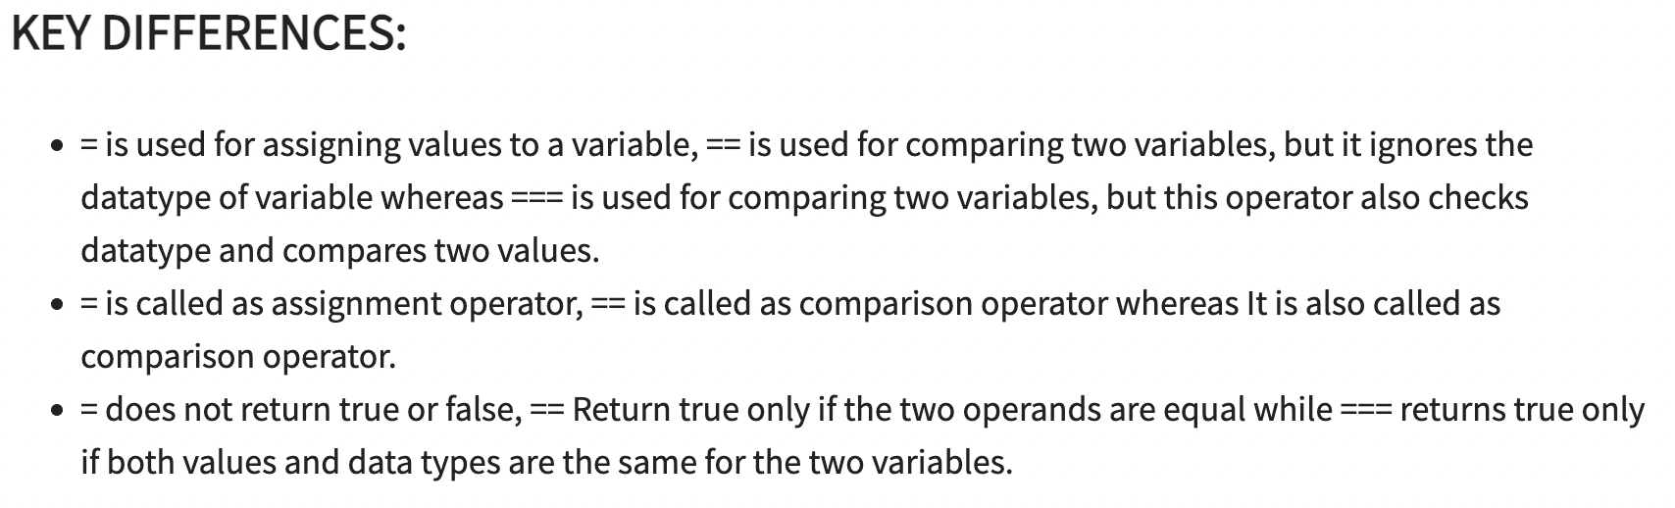
= or == or ===
= is assigning
== is comparing but ignores datatype
=== is comparing but checks datatype
https://www.guru99.com/difference-equality-strict-operator-javascript.html
Notes:
Now it’s time to talk comparison in Javascript!
But be careful, sometimes it may not work as you expected, .. but predictable. and that’s why many programmers don’t like Javascript.
You will learn these soon at the end of this section
One equal sign is assigning
And two equal sign is comparing
But usually we tend to use three equal signs to compare values of two variables

Slide 9
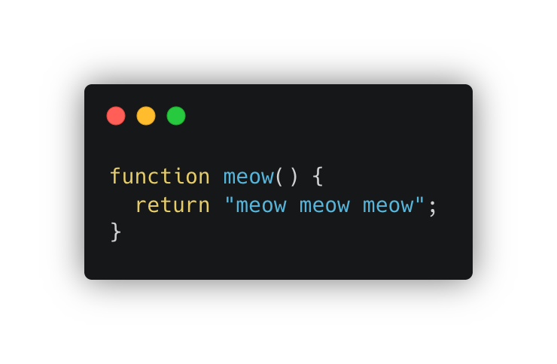
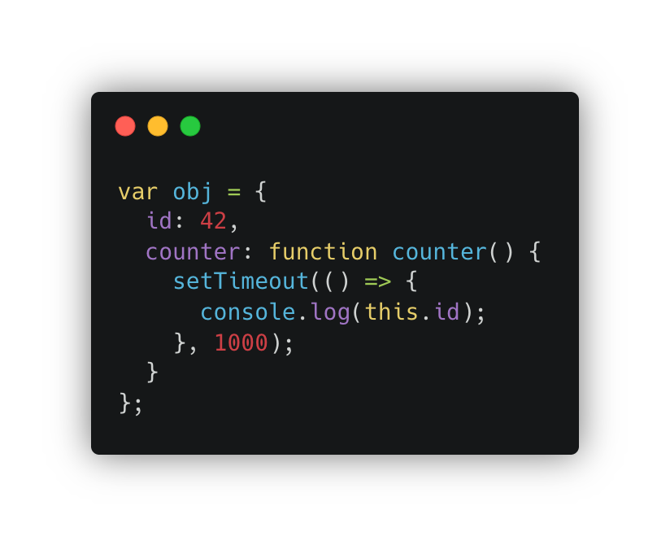
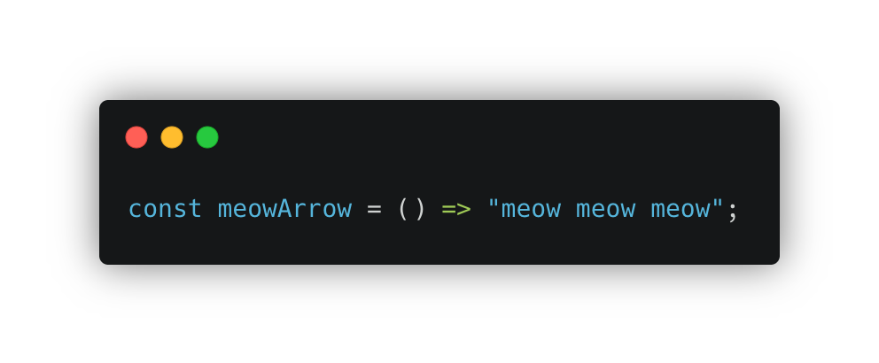
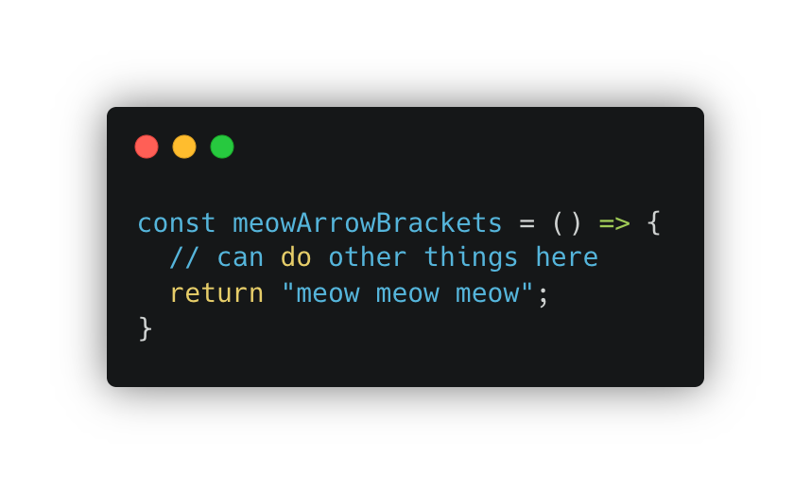
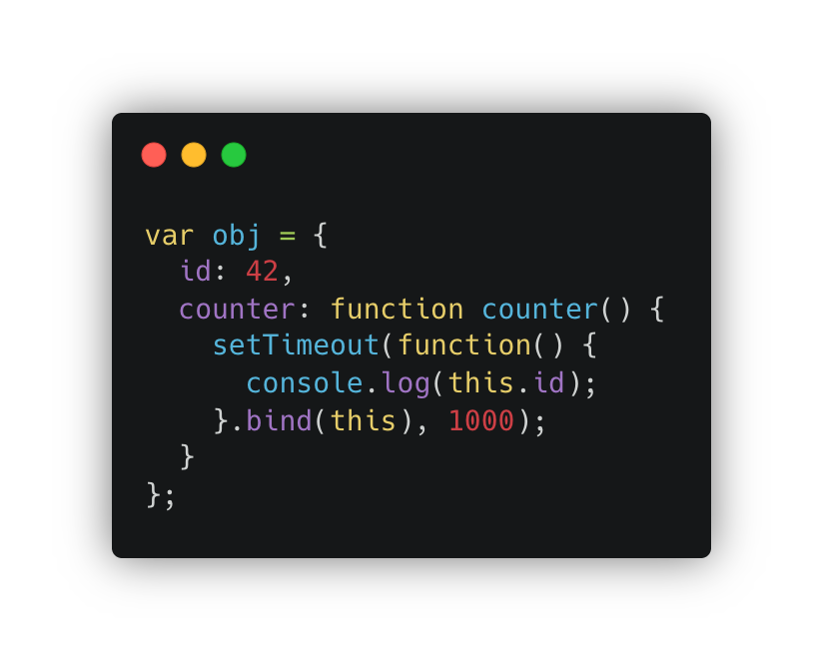
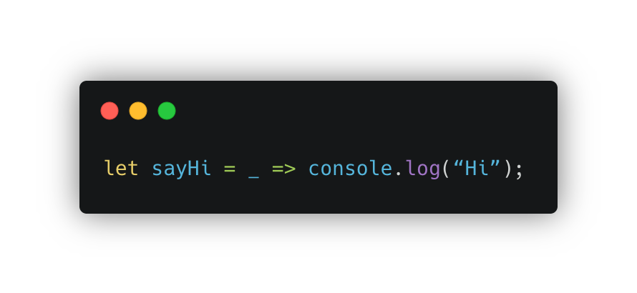
Functions
regular functions
arrow functions
difference?
https://betterprogramming.pub/difference-between-regular-functions-and-arrow-functions-f65639aba256
Notes:
There’re some functional programming influence on Javascript.
Every function is first-class functions, which means they are just like any other variable:
Stored in variables
Passed as arguments to other functions
Returned as values by functions
Stored in data structures
Also there’re arrow functions, which are compact alternative for regular functions.
`=` here is still an assignment operator, which assigns the lambda function on the right side of it to the name on its left side

Slide 10
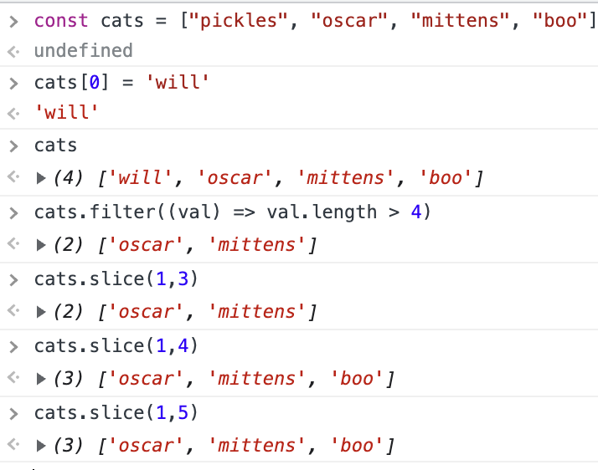
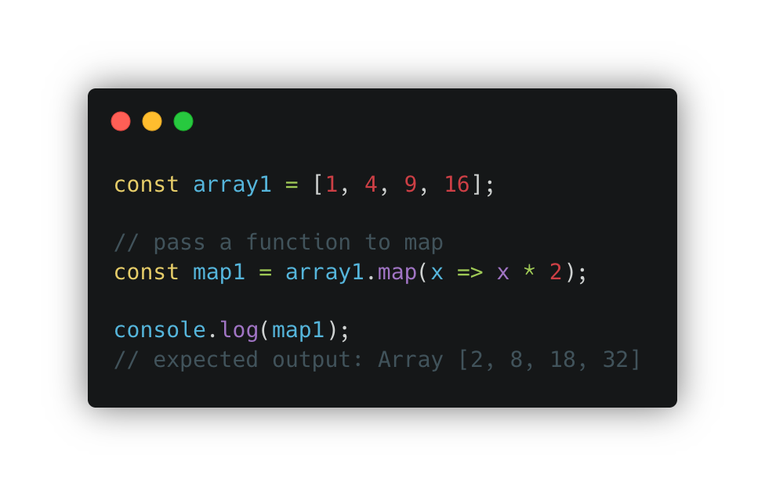
Data Structures - Arrays and Map
Notes:
Array can hold more than one value
We can use high-order functions like map/filter/reducer to manipulate arrays

Slide 11
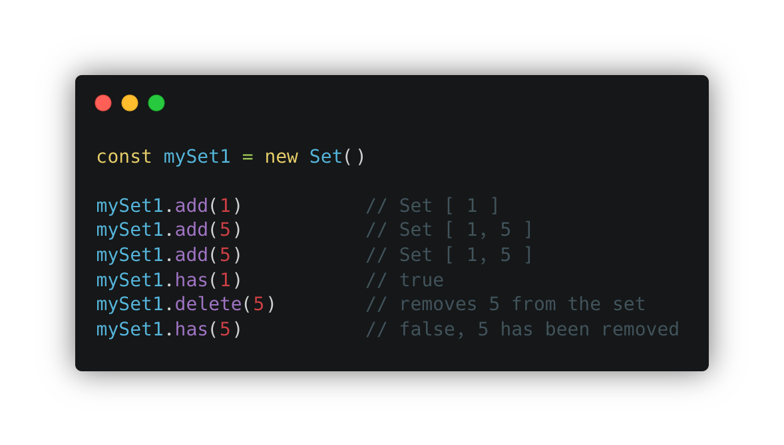
Sets
https://developer.mozilla.org/en-US/docs/Web/JavaScript/Reference/Global_Objects/Set
Notes:
Sets can only contain unique elements and has operations such as `add`, `delete`, `has` and so on

Slide 12
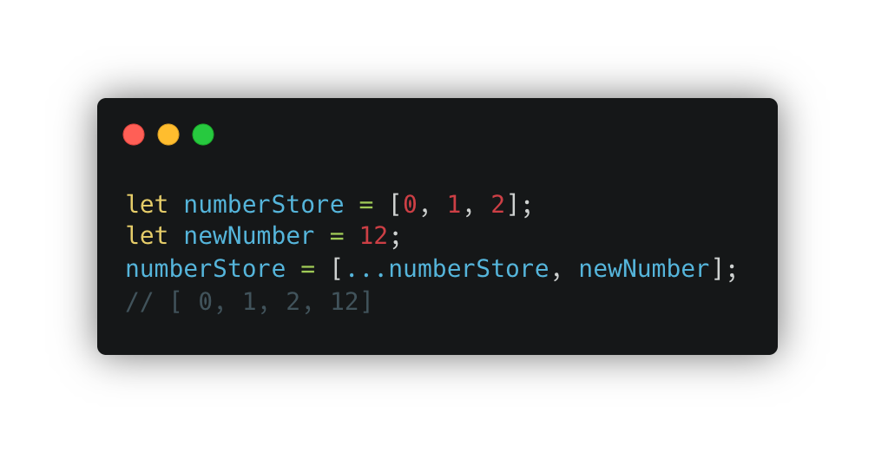
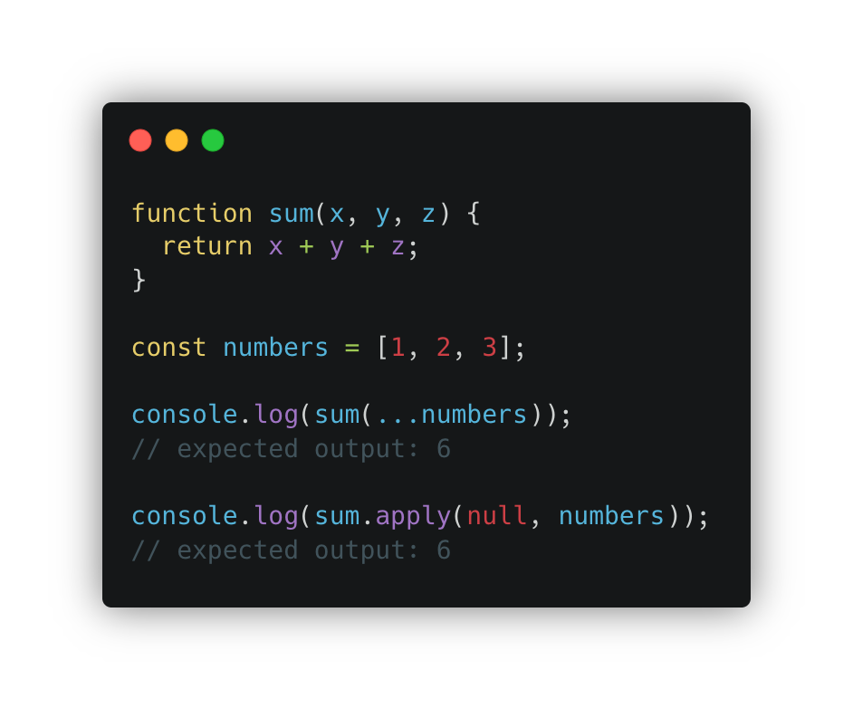
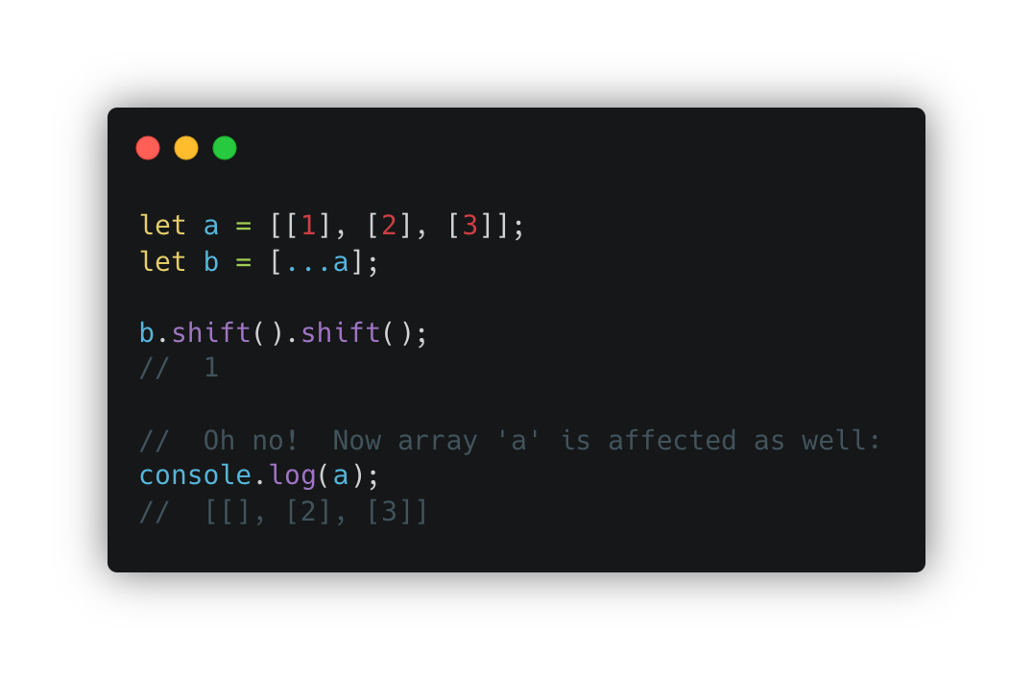
Spread
https://developer.mozilla.org/en-US/docs/Web/JavaScript/Reference/Operators/Spread_syntax
https://developer.mozilla.org/en-US/docs/Web/JavaScript/Reference/Global_Objects/Array/shift
Notes:
Spread syntax (...) allows an iterable, such as an array or string, to be expanded in places where zero or more arguments (for function calls) or elements (for array literals) are expected.
Sum requires three arguments, so we can use spread syntax to “spread” 1, 2, 3 to x, y, z

Slide 13
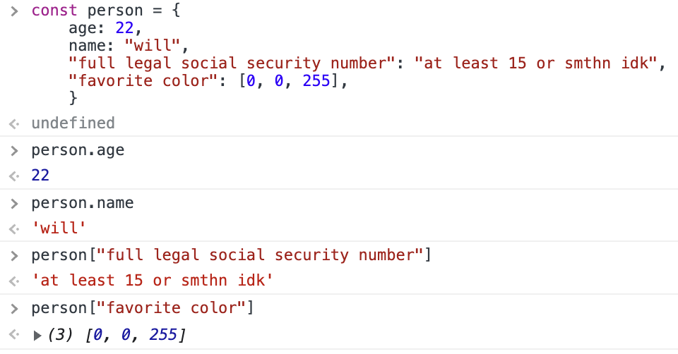
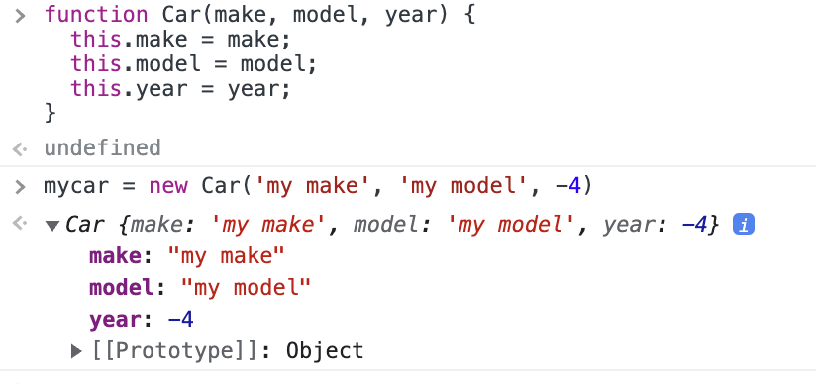
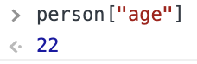
JavaScript Objects
Object.keys(...)
Object.values(...)
Object.entries(...)
Notes:
Show examples of Object static methods live

Slide 14
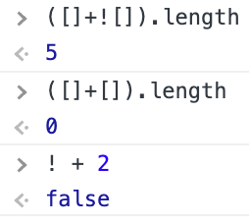
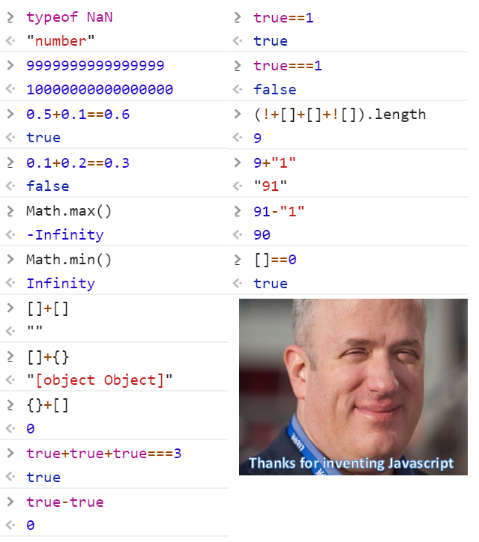
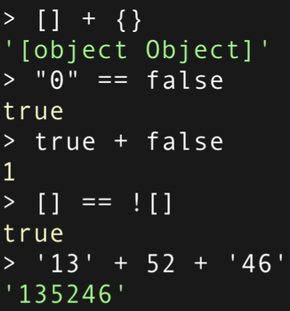
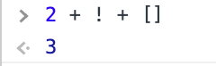
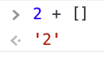
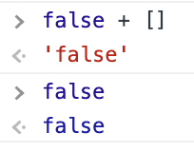
Why Does JavaScript Get Hate?
implicit coercion…

Slide 15

React

Slide 16
React
Declarative
Component-Based
Learn Once, Write Anywhere
“Most popular” frontend framework in the “most popular” programming language
How to Get Started?
npx create-react-app <app-name>
Notes:
Briefly Declarative vs Imperative
Informally, specify the general pattern / logic of the computation without worrying about the details of the control flow
Regular Expression, CSS, SQL
In the context of react, you only need to write simple views for each state in your application, but React does the update and rendering for the data change
Reusable components
Server Side usng JavaScript runtime like Node.js & mobile app React native

Slide 17

create-react-app
A tool that bootstraps everything you need to start the project
npx create-react-app my-app
cd my-app
npm start
Notes:
npx lets you run code built with Node.js and published through the npm registry.

Slide 18
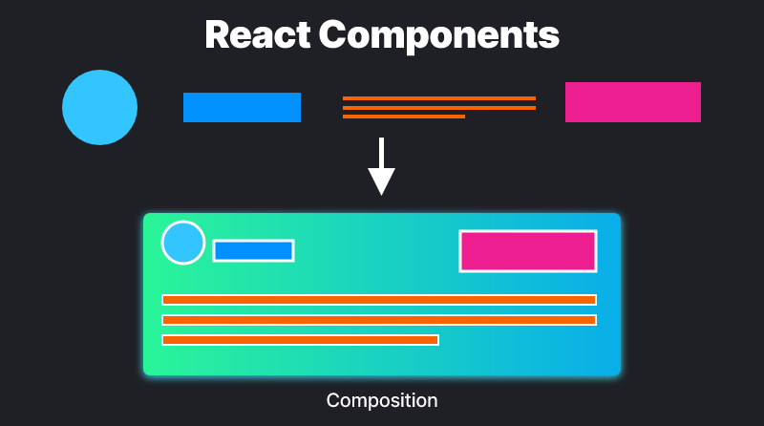
Function Components
export function Welcome(props) {
return <h1>Hello, {props.name}</h1>;
}
export const Welcome = (props) => (
<h1>Hello, {props.name}</h1>;
);
Notes:
Essential, component-based
Function components are used in modern days
Why not classed?
Reuse stateful logic
No complex lifecycle methods
Less boilerplate
No “this”

Slide 19
Props
function Welcome(props) {
return <h1>Hello, {props.name}</h1>;
}
“Properties”
JavaScript objects that contain JSX attributes and children
Function “parameters”
<Welcome name="Sara" />;
Notes:
Explain that props is an object

Slide 20
States
Similar to variables defined in the function
Or class members in a class-based component
Private & Fully Controlled by the component itself
Think of how this is useful for a HTML <form> component
class App extends Component {
constructor(props) {
super(props);
this.state = {
title: “”
}
}
...
}
this.setState({
title: “my-title”
});
function App() {
const [
title,
setTitle
] = useState(“”);
...
setTitle(“my-title”);
}
Notes:
State in class must be object, state in hooks is not necessarily so

Slide 21
Props & States in One Example
function Example(props) {
const [count, setCount] = useState(0);
return (
<div>
<p>{props.name} clicked {count} times</p>
<button onClick={() => setCount(count + 1)}>
Click me
</button>
</div>
);
}
// In the parent’s component
<Example name=”Sara” />
Notes:
Ask students to think about that this component does

Slide 22
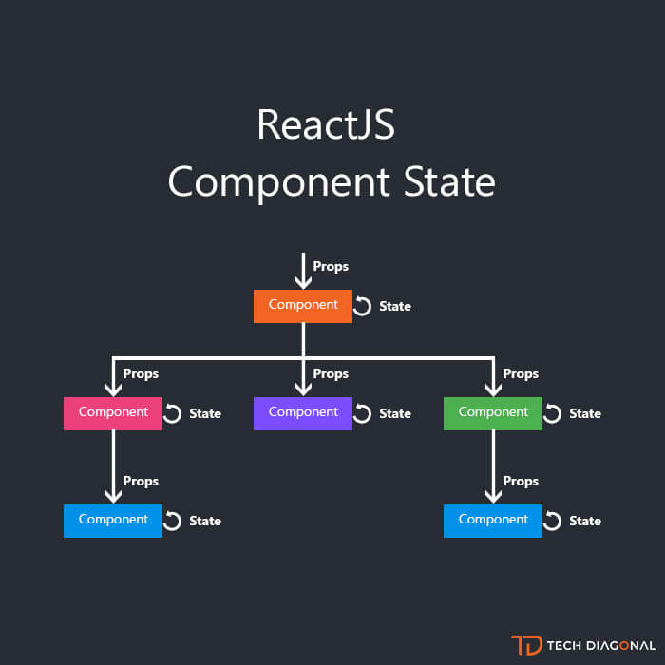
Props vs States
both hold information that influences the output of render
props: properties, immutable
states: mutable, internal to the component
Image: https://www.techdiagonal.com/reactjs_courses/beginner/reactjs-component-state/
Notes:
constructor readonly params versus private variables in OOP

Slide 23
A Gentle Intro to Hooks
All the hooks in React start with use
useState<S>(initialState: S | (() => S))
Returns a stateful value, and a function to update it.
useEffect(effect: EffectCallback, deps?: DependencyList)
Perform side effects in function components
deps: Only trigger the effect when value in deps changed
if empty, then only after component initially renders
e.g. fetch data, perform UI updates

Slide 24
From class to function
import DataComponent from “./DataComponent”;
class App extends Component {
constructor(props) {
super(props);
this.state = { data: [] };
}
async componentDidMount() {
const result = await fetch(“/api/data”);
this.setState({ data: result.data });
}
render() {
return (
<div>
{this.state.data.map((x, i) => (
<DataComponent key={i} data={x} />
))}
</div>
);
}
}
What does this component do?
Why does it use state instead of props?
For anyone interested in ES6 Promises and/or async-await syntax, check these links!
ES6 Promises
await operator

Slide 25
From class to function
import DataComponent from “./DataComponent”;
function App(props) {
const [data, setData] = useState([]);
useEffect(() => {
const fetchData = async () => {
const res = await fetch(“/api/data”);
setData(result.data);
};
fetchData().catch(console.err);
}, []);
return (
<div>
{data.map((x, i) => (
<DataComponent key={i} data={x} />
))}
</div>
);
}
What does this component do?
How does it differ from the previous class-based version?
For anyone interested in ES6 Promises and/or async-await syntax, check these links!
ES6 Promises
await operator
state and useEffect

Slide 26
Other Helpful Technologies
React-Redux
Global state management
React-Query
Data fetching and state management
React Bootstrap
Build your app quickly
TailWind CSS
Customize your app pixel by pixel
Material UI
Alternative to Bootstrap
Notes:
Encourage to check links

Slide 27
Q & A + Live Coding Demo
Notes:
https://github.com/paul-serafimescu/f22-cs35L-frontend-ws

